Slide 1
Speed of Sound

Slide 2

In this Smart Lesson you will learn to:
Recall the factors that affect the speed of sound.
Calculate the speed of sound from the wavelength and frequency of a wave.

Slide 3

When there is a storm, you may have noticed that you see the flash of lightning before you hear the clap of thunder.
This means light travels faster than sound, but how much faster?
And does sound always travel at the same speed?

Slide 4
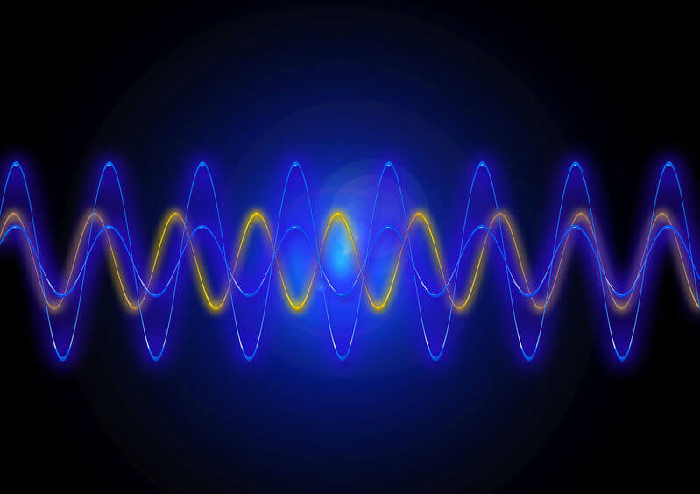
The speed of sound is determined by the medium it travels through.
Each medium has a different density and different elastic properties (elasticity). This means that the speed of sound changes depending on what it's travelling through.
For example, sound travels faster through water than air.

Slide 5
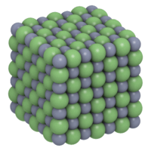
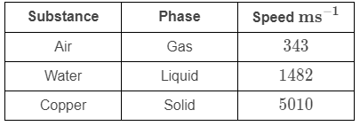
The phase of matter (e.g. whether it is solid, liquid, or gas) has the largest impact on the elastic properties of the medium.
Sound travels fastest in solids because they have the strongest interactions between particles. Strong interactions mean that particles respond rapidly to collisions, allowing the wave to travel faster.
Sound travels slowest in gases because they have the weakest interactions between particles.

Slide 6

After phase, density of the medium has the largest effect on the wave speed.
If two media are the same phase but have different densities, sound will travel at different speeds through these two media.
High density in solids results in sound travelling more slowly. This is because the interactions between the neighbouring particles occur more slowly as it requires more energy to move the larger particles. In gases, however, higher density often reflects particles being closer together, so sound often travels faster in denser gases.

Slide 7
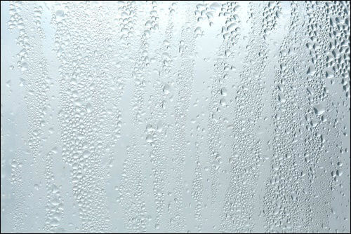
Humidity can also affect the speed of sound.
Moist air is less dense than dry air, due to lighter molecules, so sound travels faster at high humidity. This is because water vapour is less dense than oxygen and nitrogen. However, humidity has very little effect except at high altitudes.

Slide 8

Temperature also affects the speed of sound.
Warm air has higher kinetic energy than cold air, so the molecules vibrate faster and therefore sound travels faster.

Slide 9
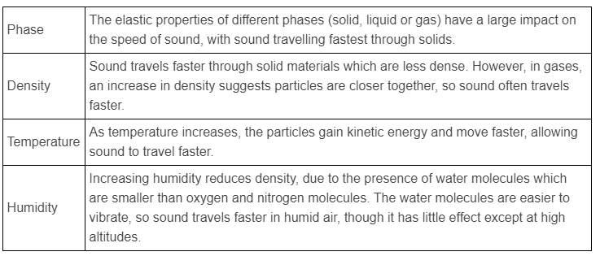
In summary, there are several factors that affect the speed of sound.

Slide 10
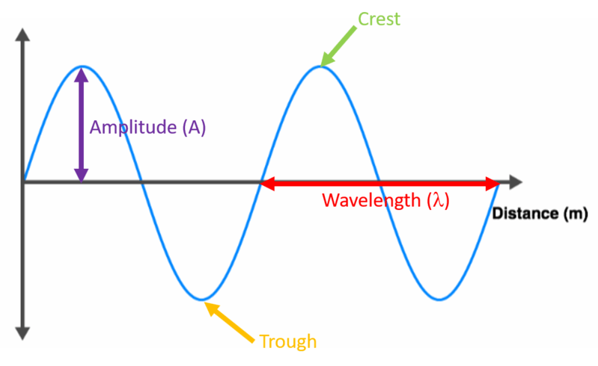
As sound is a wave, the same formula is used to calculate the speed of sound as any wave.
v=fλ
Where v is the speed of sound (ms⁻¹), f is the frequency (Hz) and λ is the wavelength (m).

Slide 11
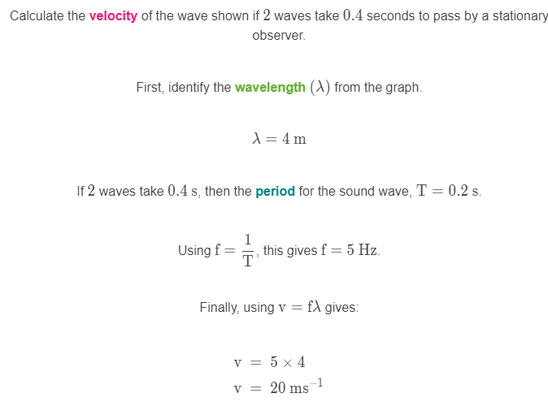
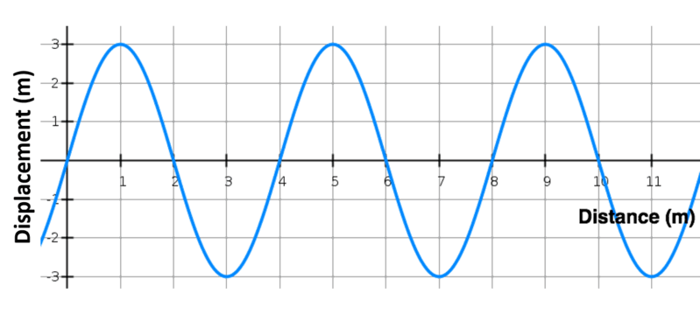
Calculating wave velocity.

